Slide 1

Quinceañeras at the Capitol

Slide 2
Essential Questions
What tools are available to young people who feel marginalized to help them influence the thoughts and actions of others?
What does effective civic action look like? What makes some civic action successful, while other civic actions have less impact?
When you are too young to vote, how can you make your voice heard?

Slide 3
Think-Pair-Share
When you are too young to vote, how can you make your voice heard?

Slide 4
Goals/Outcomes
A goal of this lesson is to foster civic knowledge, skills, and attitudes, including deepening civic knowledge through reflection on a particular story of youth-led civic action.
Students will hone their civic skills and nurture civic attitudes by identifying the choices, both strategic and tactical, made by the young women who participated the protect.
Students will consider the relationship between individual and group identity and the civic choices that people make.

Slide 5
Context
On July 2017 media from around the world flashed images of fifteen Latina young women wearing quinceañera dresses speaking out to affirm their identities and to protest what they experienced and perceived to be a grave injustice—SB4, a Texas immigration law.
According to the Texas Chronicle:
“As passed, SB 4 allows local law enforcement officers to question the immigration status of people they detain or arrest and punishes local government department heads and elected officials who don’t cooperate with federal immigration “detainers” — requests by agents to turn over immigrants subject to possible deportation — in the form of jail time and penalties that exceed $25,000.”

Slide 6
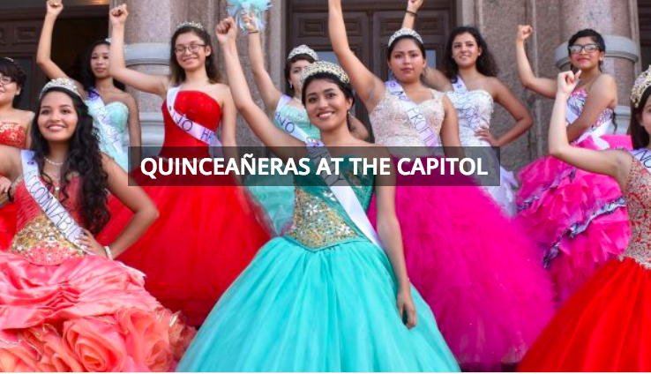

Slide 7
Gallery Walk
One your own, walk around the “gallery”
You will be looking for evidence to help you identify the strategic and tactical choices made by organizers and participants at the protest.
Use the 10 Questions for Chagemakers graphic organizer to structure you viewing.
Note: The 10 Questions for Changemakers were designed by Danielle Allen as prompts to use to help people design effective, equitable, and self-protective civic interventions for social change in the digital age.

Slide 8
Small Group Discussion
Share, discuss, and refine your answers to the questions.
Choose a just a few key questions that stood out, either because of the question itself or because you would like to discuss how the young women addressed it.

Slide 9
Reflection
Why do you think the quinceañera protests captured so much media attention?
Was the quinceañera protest successful? If so, in what ways?
  Do you think the protests would have been able to influence the thoughts and actions of others who might not have agreed with them ahead of time?
  Might the protests have helped them gain allies in their cause?
How does this story speak to the essential questions for the lesson?
  What tools are available to young people who feel marginalized to help them influence the thoughts and actions of others?
  What does effective civic action look like? What makes some civic action successful, while other civic actions have less impact?
  When you are too young to vote, how can you make your voice heard?

