Slide 1
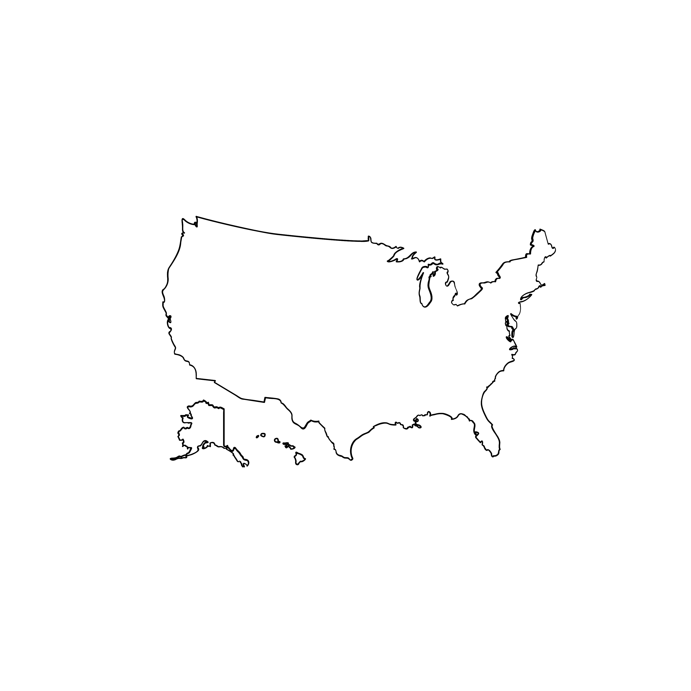

Colonial Migration
Middle Passage and Slavery
Westward Expansion
Forced Migration of Indigenous Peoples
Generations of Immigration
The Great Migration
Refugees and Asylum Seekers
Seven migrations and American identity

